Slide 1

RESTURENT MANAGEMENT SYSTEM
PRESENTED BY-
Biraj Khound.
(210720043009)
Joshna Boro.
(210720043015)

Slide 2
Objectives
The main objective for the project is to handle the entire activities of restaurant management system in an efficient way.
To provide security to a restaurant’s data as only authorized user is allowed to access the data.
To help the administrator of the restaurant to manage the restaurant more effectively and in a well-organized manner.
To facilitate receipt generation by the system that reduces the workload to a great extent.
The system contains a discount feature where the owner can give discount to customers.
It contains SGST and CGST also.
The system also contains a database where all the data are stored safely.
This project provides a lot of features to manage in very well manner.
The system has a good appearance and is very easy to operate. It is very simple, easy to access and it saves our time.

Slide 3
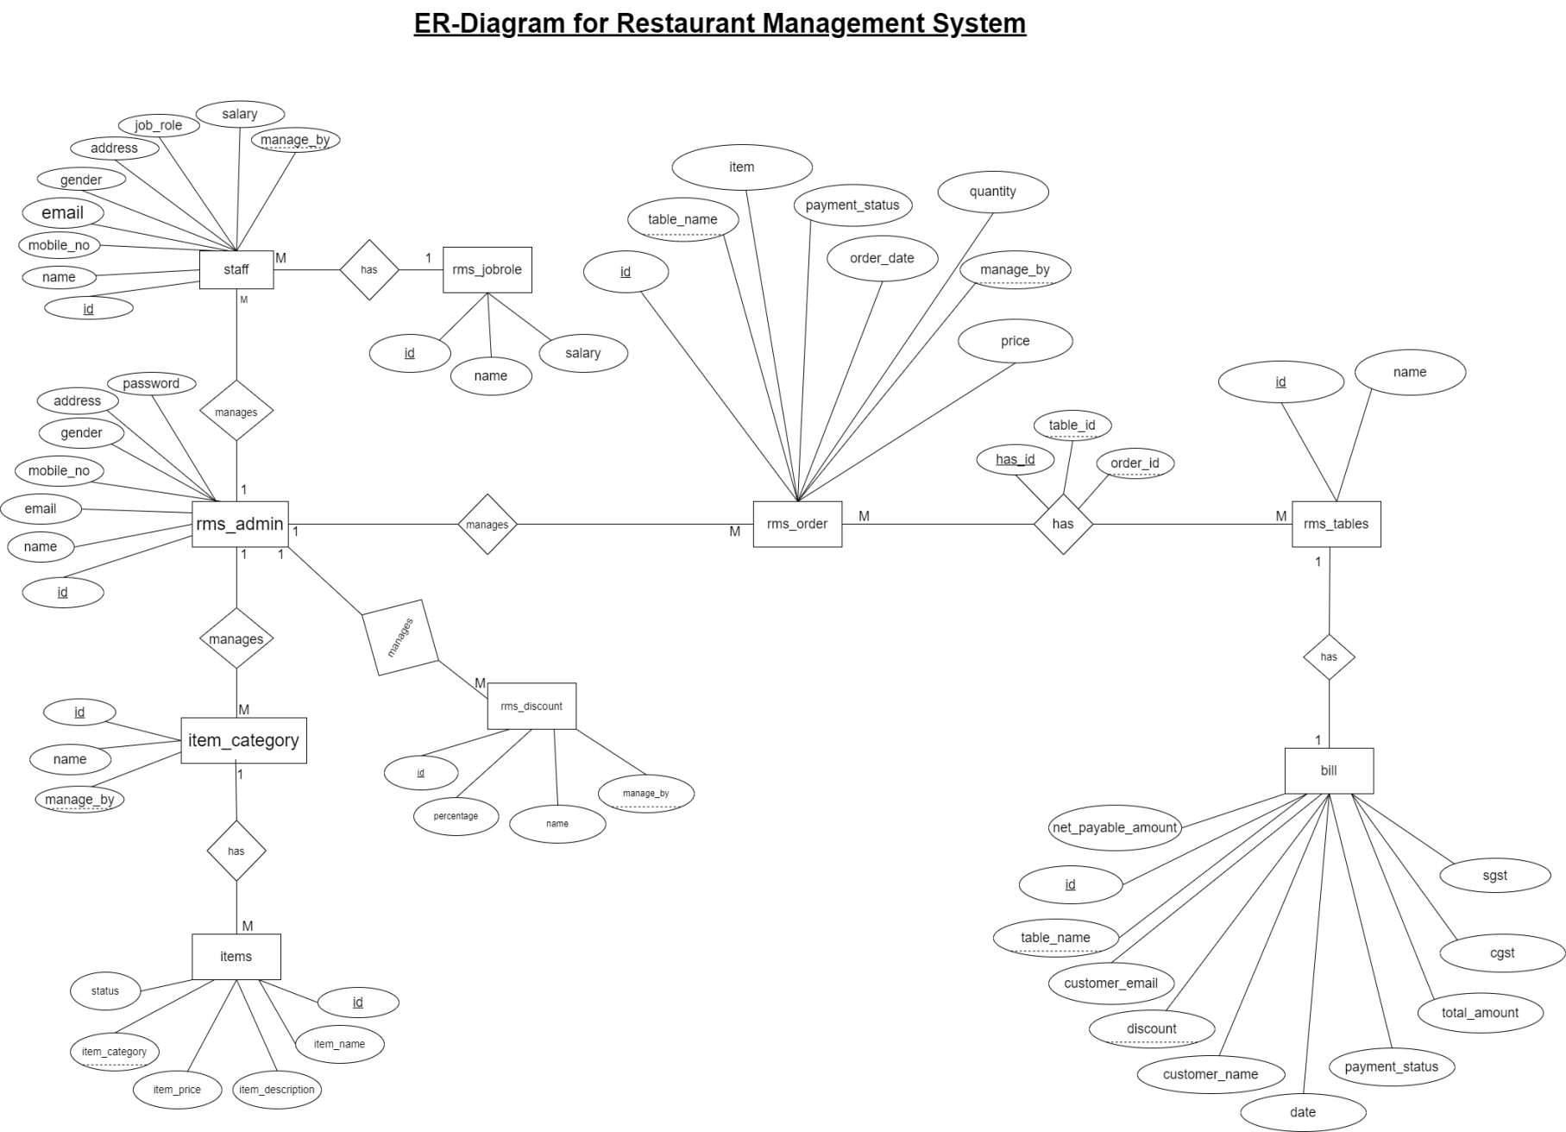
Entity-Relationship Diagram

Slide 4

THANK YOU
PRESENTED BY-
Biraj Khound.
(210720043009)
Joshna Boro.
(210720043015)

